Slide 1

HOOLIGAME
War on Stadium
António Cordeiro
Artur Lee

Slide 2

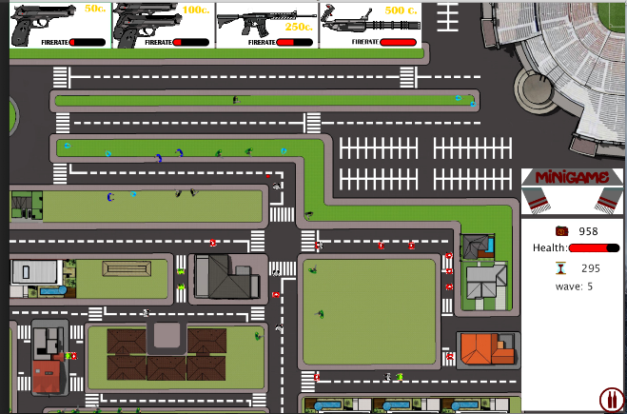
HOOLIGAME
Tower Defense
Top-Down
&
Side View

Slide 3

Main Menu

Slide 4
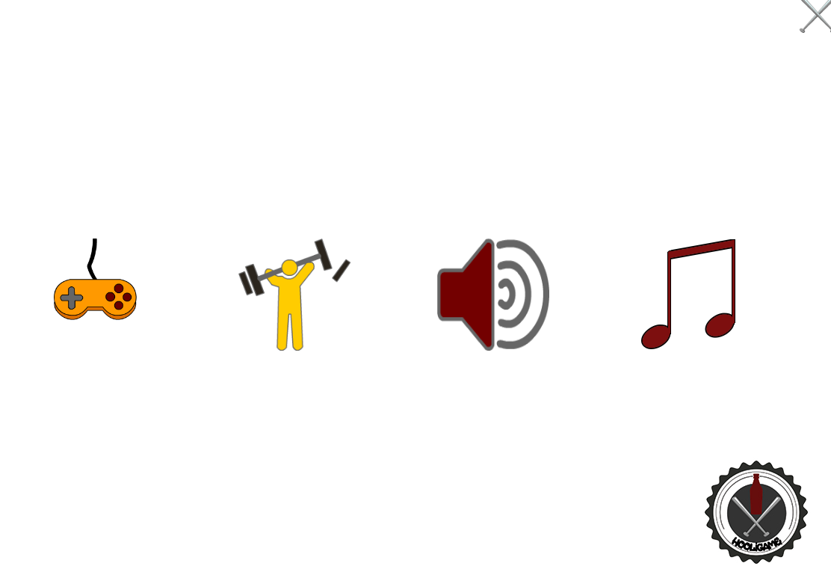
Settings

Slide 5
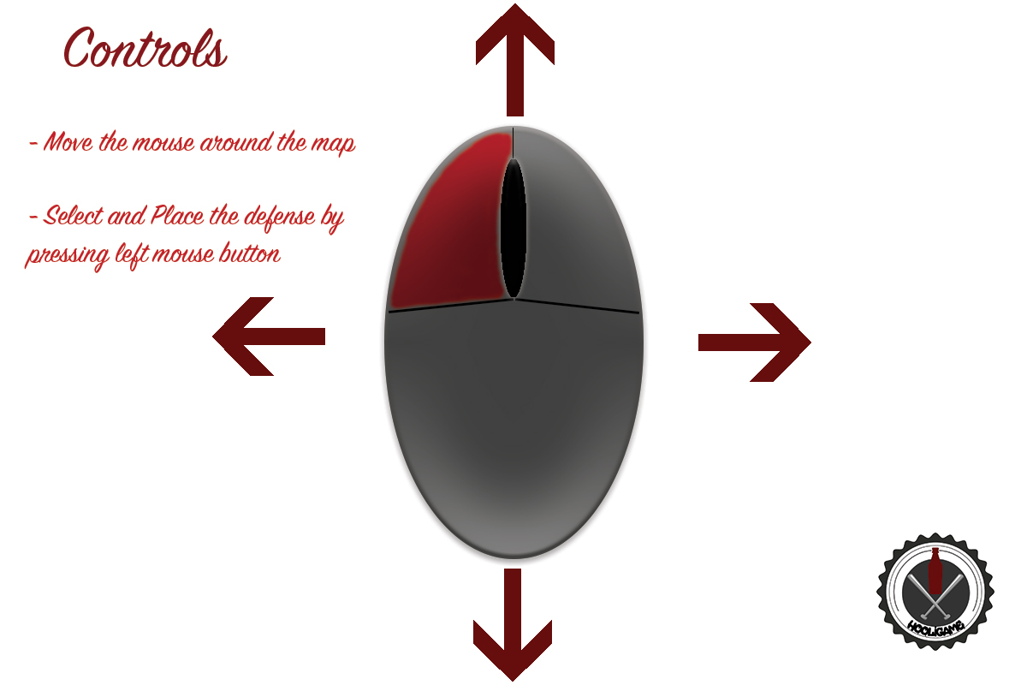
Controls

Slide 6

Difficulty

Slide 7
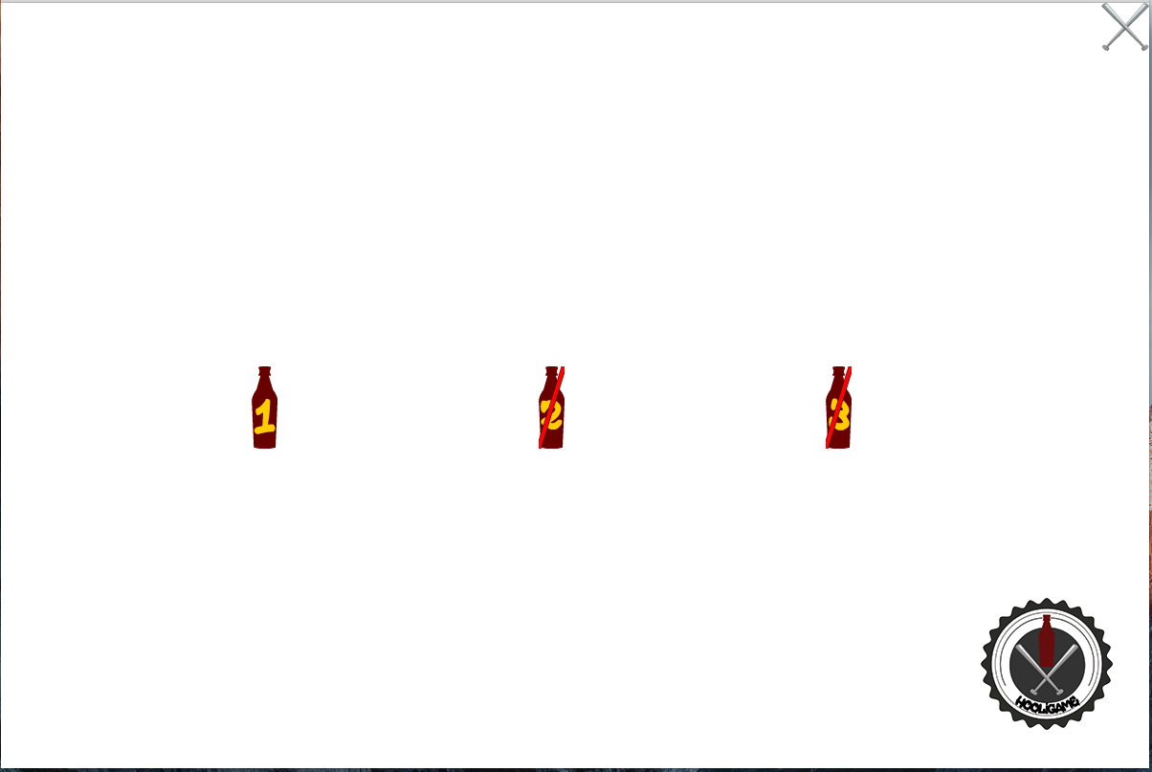
Level selection

Slide 8
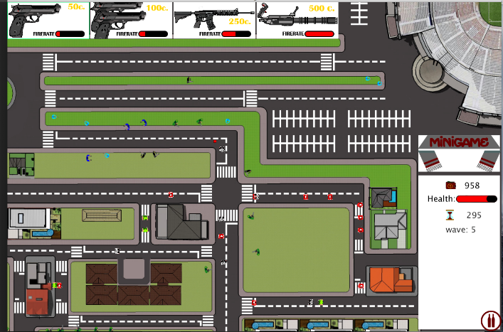
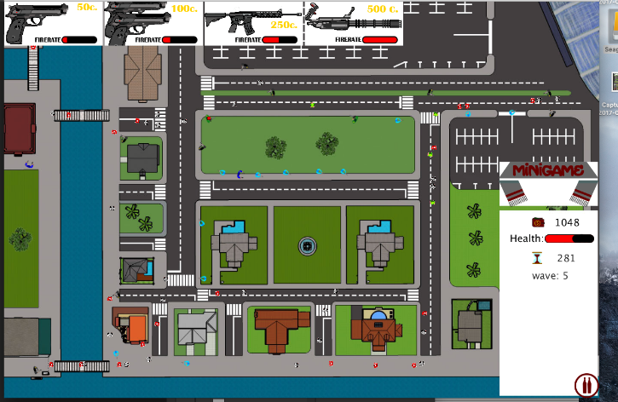
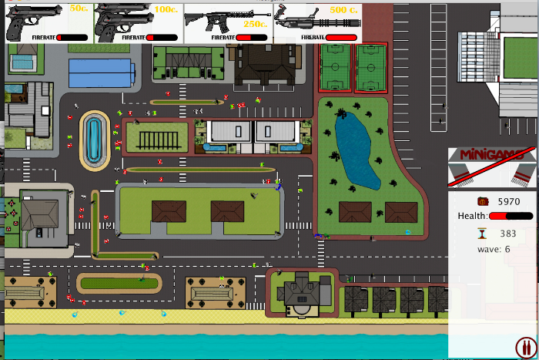
Different levels
Level 1
Level 2
Level 3

Slide 9

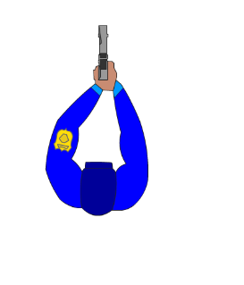
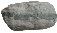



instructions

Slide 10
Minigame

Slide 11


instructions

Slide 12
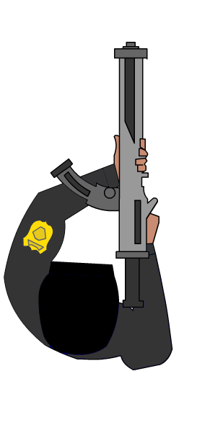

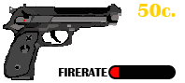
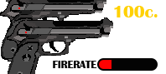
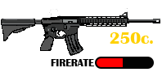
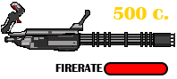

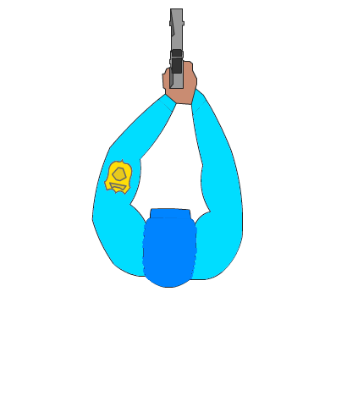
weapons
Supreme army commander
Minigame
Regular officer
Pistol
Police chief
2 Pistol
Federal agente
Assault Rifle
Characteristics:
DAMAGE = 15
FIRERATE = 1 BULLET P/ SECOND
Characteristics:
DAMAGE = 15
FIRERATE = 2 BULLET P/ SECOND
Characteristics:
DAMAGE = 50
FIRERATE = 1 BULLET P/ SECOND
Characteristics:
DAMAGE = 20
FIRERATE = 10 BULLET P/ SECOND

Slide 13




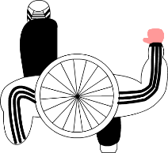

Enemies
LEADER
BOSS
CHAMPION
Characteristics:
SPEED = x100
HEALTH : 100
Characteristics:
SPEED = x70
HEALTH : 200
Characteristics:
SPEED = x50
HEALTH : 500

Slide 14


